Slide 1
Spring Security – SSO With SAML Integration

Slide 2

Agenda
SSO
SSO Terminologies
SSO Flow
SAML
SAML Request
SAML Response
SP Configuration
IdP Configuration
Self Signed Certificates

Slide 3
Single Sign-On - SSO
SSO is an authentication process that allows users to get access to multiple applications with a single sign in.
Advantages Of Using SSO
User need not remember multiple passwords as only one credential can get access for multiple applications.
User management becomes easy for the admin.
Example : Once you sign in to your google account, you can access all the google services like Gmail, google maps, google drive, etc. without need to sign in to each service seperately.

Slide 4
SSO Terminologies
Service Provider(SP) - SP is the service or application to which the users requires access. Ex: Gmail, YouTube and other Google services.
Identity Provider(IdP) - The IdP is a system that authenticates a user and sends the user credentials along with their access rights for the service to the SP. Ex: Google
SP Initiated SSO - In this process, a user will request to the service provider to access the protected pages. The service provider will initiate the request to the identity provider to validate the user.
IDP Initiated SSO - In this process, a user will login into the identity provider website and tries to access the service provider resources remotely. In this case, IdP will initiate the request to service provider and post the authentication response to allow access to resources.

Slide 5
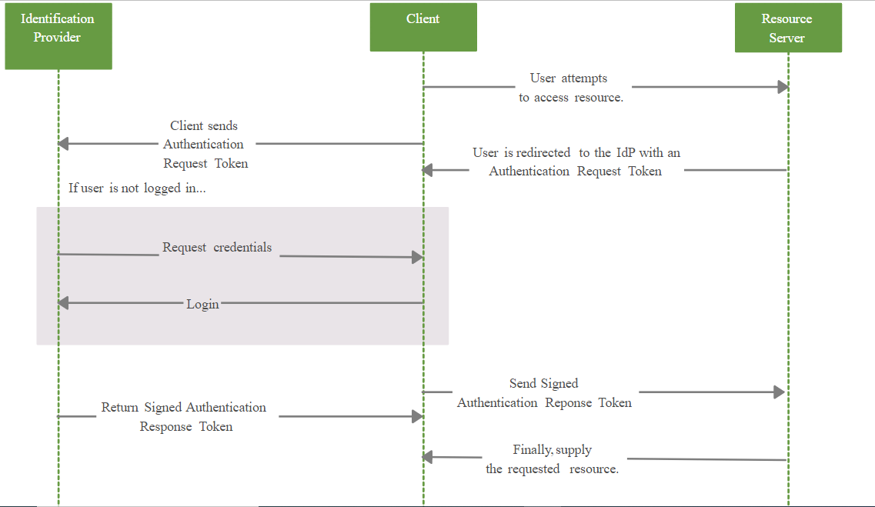
SSO Flow Diagram

Slide 6
SAML – Secure Assertion Markup Language
Security Assertion Markup Language (SAML) is an open authentication standard that allows for the secure exchange of user identity information from one party to another.
SAML is a digitally signed XML document which includes information about user, source and destination systems which are intended to use this XML document and other information to validate the XML signature.
The SAML 2.0 Login, saml2Login(), feature provides an application with the capability to have users log in to the application by using their existing account at an SAML 2.0 Identity Provider.
The SAML features of spring security is packed into two dependencies spring-security-saml2-core and spring-security-saml-dsl.

Slide 7
SAML Dependencies
spring-security-saml2-core – saml2 core is an extension of Spring security to support basic SAML processing for single sign-on.
spring-security-saml-dsl-core – saml dsl is used along with saml 2 core which holds the basic configuration for request mapping, filter and authentication provider configuration.
spring-security-saml-dsl-core contains below request mapping details configured by default.
/saml/SSO – This is success callback URL and IDP uses this request mapping to post the SAML.
/saml/metadata – This mapping is used to display and read the metadata file.
/saml/login – Responsible to generate the login request and redirect to IDP page for login.

Slide 8
SAML Request
Below is a sample SAML authentication request from SP. This request is stringified, encoded and passed in the query string to the IdP.
<samlp:AuthnRequest xmlns:samlp="urn:oasis:names:tc:SAML:2.0:protocol"
xmlns:saml="urn:oasis:names:tc:SAML:2.0:assertion"
ID="ONELOGIN_809707f0030a5d00620c9d9df97f627afe9dcc24" Version="2.0"
IssueInstant="2021-03-09T10:26:17.210Z"
ProviderName="SP test" IssueInstant="2014-07-16T23:52:45Z"
Destination="http://idp.example.com/SSOService.php"
ProtocolBinding="urn:oasis:names:tc:SAML:2.0:bindings:HTTP-POST"
AssertionConsumerServiceURL="http://sp.example.com/demo1/index.php?acs">
<saml:Issuer>http://sp.example.com/demo1/metadata.php</saml:Issuer>
<samlp:NameIDPolicy Format="urn:oasis:names:tc:SAML:1.1:nameid-format:emailAddress" AllowCreate="true"/>
</samlp:AuthnRequest>

Slide 9
Components Of A SAML Request
ID – The ID is generated by the SP to identify the request and the IdP will respond to this request with this ID within its SAML response.
IssueInstant – Timestamp at which the request was created which could be used by the IdP to respond only to requests within the defined timestamp. Ex: Requests older than 5mins can be rejected by IdP.
Destination – The url of the IdP to which the request is being sent which is verified by Idp to ensure that it is the actual recipient of the request.
AssertionConsumerServiceURL – The url to which the user has to redirected after successful authentication.
Issuer – The name of the service provider(SP) which is used by the IdP for verification and is also added in the SAML response again for the verification of the SP.

Slide 10
SAML Response
Below is a sample SAML authentication response from IdP
<samlp:Response xmlns:samlp="urn:oasis:names:tc:SAML:2.0:protocol"
xmlns:saml="urn:oasis:names:tc:SAML:2.0:assertion"
ID="_8e8dc5f69a98cc4c1ff3427e5ce34606fd672f91e6" Version="2.0"
IssueInstant="2014-07-17T01:01:48Z"
Destination="http://sp.example.com/demo1/index.php?acs"
InResponseTo="ONELOGIN_4fee3b046395c4e751011e97f8900b5273d56685">
<saml:Issuer>http://idp.example.com/metadata.php</saml:Issuer>
<samlp:Status>
<samlp:StatusCode Value="urn:oasis:names:tc:SAML:2.0:status:Success"/>
</samlp:Status>
<saml:Assertion xmlns:xsi="http://www.w3.org/2001/XMLSchema-instance"
xmlns:xs="http://www.w3.org/2001/XMLSchema"
ID="pfx22c3d8fa-baaa-d261-336e-37af402180be" Version="2.0"
IssueInstant="2014-07-17T01:01:48Z">
<saml:Issuer>http://idp.example.com/metadata.php</saml:Issuer>
<ds:Signature xmlns:ds="http://www.w3.org/2000/09/xmldsig#">
<ds:SignedInfo><ds:CanonicalizationMethod Algorithm="http://www.w3.org/2001/10/xml-exc-c14n#"/>
<ds:SignatureMethod Algorithm="http://www.w3.org/2000/09/xmldsig#rsa-sha1"/>

Slide 11
<ds:Reference URI="#pfx22c3d8fa-baaa-d261-336e-37af402180be">
<ds:Transforms><ds:Transform Algorithm="http://www.w3.org/2000/09/xmldsig#enveloped-signature"/>
<ds:Transform Algorithm="http://www.w3.org/2001/10/xml-exc-c14n#"/></ds:Transforms>
<ds:DigestMethod Algorithm="http://www.w3.org/2000/09/xmldsig#sha1"/>
<ds:DigestValue>NdFhKS45JngnlQz0dDJiH9sonQk=</ds:DigestValue></ds:Reference>
</ds:SignedInfo>
<ds:SignatureValue>n6ZOgicd5XU9PjAGA+jiTnWG35ikz9vZ82ws84dy4fT53xyymokFLhOStzubv5SPgD5gkDJ2g64Wy
DnQmfM+aLugYnOVxX391meEHsX36b5lUk8I9tuNRytvuAnMDZmUEGi4eLEck+kNqH435++ESdw7HVqMPtMgVNgvLi8UH
cA=</ds:SignatureValue>
<ds:KeyInfo><ds:X509Data><ds:X509Certificate>MIICajCCAdOgAwIBAgIBADANBgkqhkiG9w0BAQ0FADBSMQswCQY
DVQQGEwJ1czETMBEGA1UECAwKQ2FsaWZvcm5pYTEVMBMGA1UECgwMT25lbG9naW4gSW5jMRcwFQYDVQQDDA5zcC5leGF
tcGxlLmNvbTAeFw0xNDA3MTcxNDEyNTZaFw0xNTA3MTcxNDEyNTZaMFIxCzAJBgNVBAYTAnVzMRMwEQYDVQQIDApDYWx
pZm9ybmlhMRUwEwYDVQQKDAxPbmVsb2dpbiBJbmMxFzAVBgNVBAMMDnNwLmV4YW1wbGUuY29tMIGfMA0GCSqGSIb3DQE
BAQUAA4GNADCBiQKBgQDZx+ON4IUoIWxgukTb1tOiX3bMYzYQiwWPUNMp+Fq82xoNogso2bykZG0yiJm5o8zv/sd6pGo
uayMgkx/2FSOdc36T0jGbCHuRSbtia0PEzNIRtmViMrt3AeoWBidRXmZsxCNLwgIV6dn2WpuE5Az0bHgpZnQxTKFek0B
MKU/d8wIDAQABo1AwTjAdBgNVHQ4EFgQUGHxYqZYyX7cTxKVODVgZwSTdCnwwHwYDVR0jBBgwFoAUGHxYqZYyX7cTxKV
ODVgZwSTdCnwwDAYDVR0TBAUwAwEB/zANBgkqhkiG9w0BAQ0FAAOBgQByFOl+hMFICbd3DJfnp2Rgd/dqttsZG/tyhIL
WvErbio/DEe98mXpowhTkC04ENprOyXi7ZbUqiicF89uAGyt1oqgTUCD1VsLahqIcmrzgumNyTwLGWo17WDAa1/usDhe
tWAMhgzF/Cnf5ek0nK00m0YZGyc4LzgD0CROMASTWNg==</ds:X509Certificate></ds:X509Data></ds:KeyInfo>
</ds:Signature>

Slide 12
<saml:Subject>
<saml:NameID SPNameQualifier="http://sp.example.com/demo1/metadata.php"
Format="urn:oasis:names:tc:SAML:2.0:nameid-format:transient">_ce3d2948b4cf20146dee0a0b3dd6f69b6cf86f62d7</saml:NameID>
<saml:SubjectConfirmation Method="urn:oasis:names:tc:SAML:2.0:cm:bearer">
<saml:SubjectConfirmationData NotOnOrAfter="2024-01-18T06:21:48Z"
Recipient="http://sp.example.com/demo1/index.php?acs" InResponseTo="ONELOGIN_4fee3b046395c4e751011e97f8900b5273d56685"/>
</saml:SubjectConfirmation>
</saml:Subject>
<saml:Conditions NotBefore="2014-07-17T01:01:18Z" NotOnOrAfter="2024-01-18T06:21:48Z">
<saml:AudienceRestriction>
<saml:Audience>http://sp.example.com/demo1/metadata.php</saml:Audience>
</saml:AudienceRestriction>
</saml:Conditions>
<saml:AuthnStatement AuthnInstant="2014-07-17T01:01:48Z" SessionNotOnOrAfter="2024-07-17T09:01:48Z" SessionIndex="_be9967abd904ddcae3c0eb4189adbe3f71e327cf93">
<saml:AuthnContext>
<saml:AuthnContextClassRef>urn:oasis:names:tc:SAML:2.0:ac:classes:Password</saml:AuthnContextClassRef>
</saml:AuthnContext>
</saml:AuthnStatement>

Slide 13
<saml:AttributeStatement>
<saml:Attribute Name="uid" NameFormat="urn:oasis:names:tc:SAML:2.0:attrname-format:basic">
<saml:AttributeValue xsi:type="xs:string">test</saml:AttributeValue>
</saml:Attribute>
<saml:Attribute Name="mail" NameFormat="urn:oasis:names:tc:SAML:2.0:attrname-format:basic">
<saml:AttributeValue xsi:type="xs:string">test@example.com</saml:AttributeValue>
</saml:Attribute>
<saml:Attribute Name="eduPersonAffiliation" NameFormat="urn:oasis:names:tc:SAML:2.0:attrname-format:basic">
<saml:AttributeValue xsi:type="xs:string">users</saml:AttributeValue>
<saml:AttributeValue xsi:type="xs:string">examplerole1</saml:AttributeValue>
</saml:Attribute>
</saml:AttributeStatement>
</saml:Assertion>
</samlp:Response>

Slide 14
SAML Response Components
ID – The ID for response generated by the IdP.
InResponseTo – The ID of the request for which this response belongs to.
Assertion – It is an XML document that has the details of the user. This contains the timestamp of the user login event and the method of authentication used.
Signature – It is a Base64 encoded string which protects the integrity of the assertion. (If an attacker tries to change the username in the assertion to the victim’s username, the signature will prevent the hacker from logging in as the user).
Conditions – It provides the conditions for a valid login such as how long the session can be active, etc.
Attributes – The attributes contain other information about the user like location, firstname, secondname, user group, etc.

Slide 15
IdP Configuration
Spring SAML supports various IdPs like Okta, OneLogin, etc. You can choose any one of the IdP service as your IdP. Okta is used as the IdP here for the demo.
Sign-up for the free trial of Okta developer portal.
Follow the steps in this link to create a SAML application in okta with general settings.
After adding general information, go to “SAML Configuration” tab and enter application details as mentioned below:
Single sign-on URL: https://localhost:8443/saml/
SSOAudience URL: https://localhost:8443/saml/metadata
After application creation, on next page, it will display SAML metadata URL to be used in the service provider. Copy that URL and keep it in a notepad.

Slide 16
SP Configuration
The service provider is our spring boot application. Make the following configurations in your spring boot application for integrating the IdP using SAML.
Add the below 2 dependencies to your pom.xml.
<dependency>
<groupId>org.springframework.security.extensions</groupId>
<artifactId>spring-security-saml2-core</artifactId>
<version>1.0.9.RELEASE</version>
</dependency>
<dependency>
<groupId>org.springframework.security.extensions</groupId>
<artifactId>spring-security-saml-dsl</artifactId>
<version>1.0.0.M3</version>
</dependency>

Slide 17
Self Signed Certificate
We need to run our application on https to make it work locally as we need to communicate with Okta which is running on https. To run our application on https, we will add a self signed certificate.
Use java keytool to generate self-signed certificates and place the keystore.jks file in the resource folder. Use below command to generate certificate.
keytool -genkey -keyalg RSA -alias okta -keystore keystore.jks -storepass okta123 -validity 360 -keysize 2048
Add below properties to application.properties file.
Server.port = 8443 → Port in which your application is running
server.ssl.enabled = true
server.ssl.key-alias = spring → Alias name ofcertificate you created
server.ssl.key-store = classpath:saml/keystore.jks → path to the generated certificate
server.ssl.key-store-password = secret → password created while generation the certificate
security.saml2.metadata-url = your metadata url → the metadata url you captured during IdP setup

Slide 18
Common Vulnerabilities To Be Handled In SAML
Some of the common vulnerabilities which the hackers exploit to break a SAML SSO protected application are
Signature not checked –If someone is able to change the name id (username) in the SAML response and log in as someone else due to the lack of a signature checking process. Hence, the SP should have a strong validation for the assertion consumer service.
Comment Injection –A user can be registered with an XML comment in the username as follows – email: prerit<!--notprerit-->@test.com
While processing the SAML response, the SP will ignore the comment and log us in as the victim. Hence use a strong XML parser and disable any unwanted features.

Slide 19
Thank You

